Slide 1


EPLA Overview Electric Power Load Analysis (EPLA) Revision of 12 February 2026
Dr. Norbert Doerry
http://doerry.org/norbert/MarineElectricalPowerSystems/index.htm
© 2026 by Norbert Doerry This work is licensed via: CC BY 4.0 (https://creativecommons.org/)

Slide 2
Essential Questions
What is an Electric Power Load Analysis (EPLA) and what is it used for? | Understand
What are the different analytic techniques used in conducting an EPLA and used in conjunction with an EPLA? | Understand
What is a proxy load and how is it used in an EPLA and related analyses? | Understand
How does an EPLA evolve over a ship design? | Understand

Slide 3
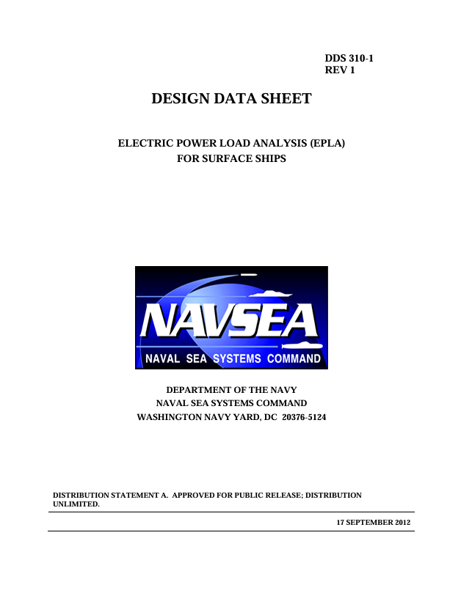
Introduction Electric Power Load Analysis (EPLA)
Tracks all electrical loads onboard the ship in a Load List
Loads modeled directly, or
Loads modeled as part of a Proxy Load
Models these loads to conduct analyses to determine required characteristics of the power system
Required power (current) ratings (power system components)
Supports many related analyses and design
Energy storage
In-rush current
Pulsed loads
Quality of service (power reliability)
Endurance fuel (fuel tank size)
Annual fuel
T9070-A3-DPC-010/310-1
(DPC 310-1)
(formerly DDS 310-1)

Slide 4
Load list Database of information about all the loads onboard the ship
Nomenclature
Ship Work Breakdown Structure (SWBS) code (3-digit) or other product breakdown structure identifier
Location on the ship (zone and/or compartment) (needed for zonal equipment and distribution system sizing)
Point(s) of connection to the power system (power panel, load center, switchboard). If more than one point of connection, indicate the primary and alternate connection (if applicable). (needed for zonal equipment and distribution system sizing)
Identification Plate (nameplate) rating (include units)
Connected load (kW)
Peak load (kW)
Power type (voltage, number of phases, frequency)
Cyclic and intermittent behavior
Power requirements during different operating modes
In-rush current demand (if applicable)
Pulsed load characteristics (if applicable)
Use during different ship operating conditions
Temperature dependence
Tolerance to power disruption (for QOS analysis)
Correlation with other loads (such as mutually exclusive loads)
Load shed priority (mission priority)
Reference to the source of data to enable traceability

Slide 5
Load factor analysis
Traditional method for performing load analysis
Determining the rating of generator sets
Works well if all individual loads are small relative to the demand power
Load factors assigned to each load for each operational condition and ambient condition
Operating load is the load factor multiplied by the connected load
Operating load represents an average value for a given time interval
Minutes for most power system equipment sizing
24 hours for endurance fuel calculations and annual fuel consumption calculations
Equipment that is not online have a load factor of 0.
Demand power for the power system component for a given operational condition and ambient condition
Sum of the operating loads for all loads plus margin and service life allowance

Slide 6
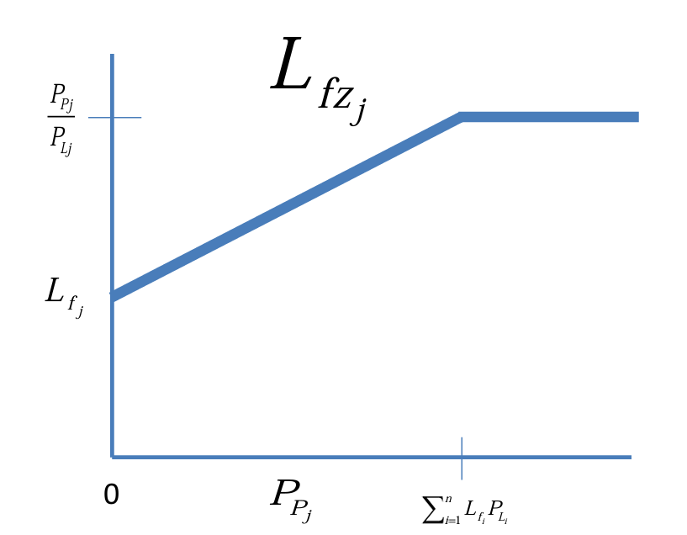
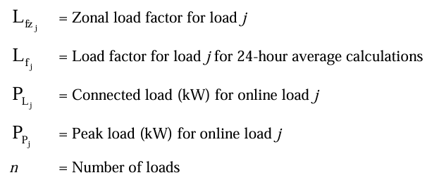
Zonal load factor analysis Modification to the load factor method
Applicable if at least one load is not small compared to the demand power.
Zonal load factors are equal to or greater than load factors
Account for loads being large
Account for peak loads being greater than average loads
Zonal operating load is product of zonal load factor and connected load
Residual zonal power demand for a load is the peak load minus the zonal operating load
Zonal demand power is the sum of the zonal operating loads plus the largest residual zonal power demand plus margin and service life allowance
DPC 310-1

Slide 7
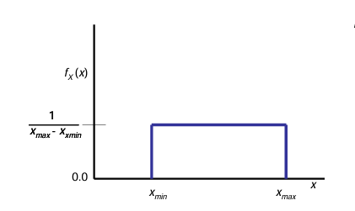
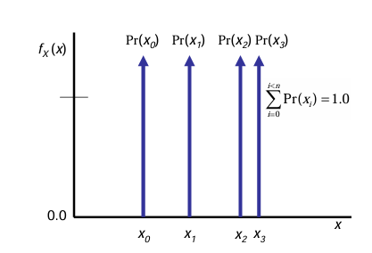
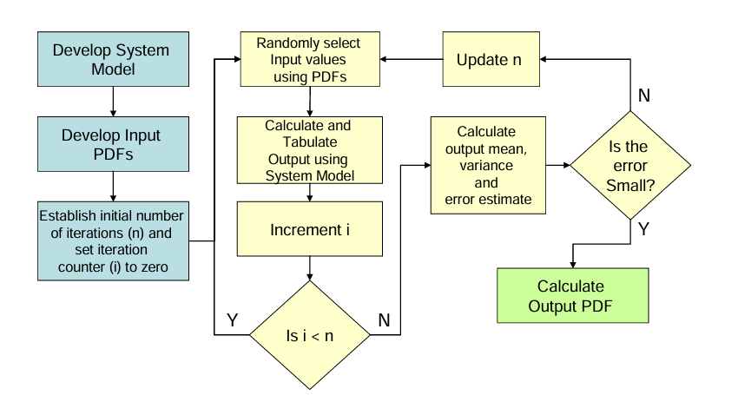
Stochastic Analysis
Models each load as a function of independent random variables
Random variables modeled as probability density functions (PDF)
Margin should be reduced
Captured in the PDF
Smaller (perhaps ¼ of that used for load factor analysis) margin accounts for “missing” loads
Service life allowance still applies
Use Monte Carlo Simulation to determine the demand power
Example PDFs
DPC 310-1
Monte Carlo Simulation

Slide 8
Modeling and simulation load analysis
Useful when …
Have large loads
Have loads with unusual electrical characteristics
Have loads requiring large amounts of rolling reserve
Correlation of loads is complex and cannot otherwise be adequately modeled by other means
Typically employs quasi-steady state modeling
Only concerned with dynamics slower than about 1 second.
Usually involves integrating individual load models
Requires development of use-cases
Realistic and stressing
Aligned with EPS-CONOPS, PS-CONOPS, etc.
Aligned with operating conditions
Worst-case demand power across all simulations typically used
Should employ a rigorous Verification and Validation effort

Slide 9
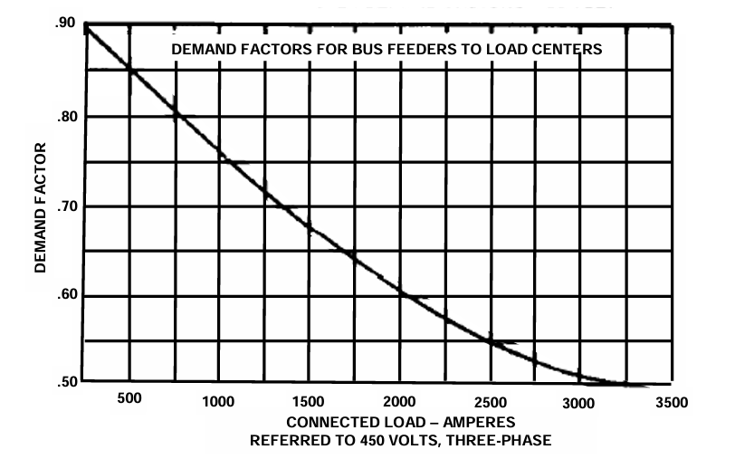
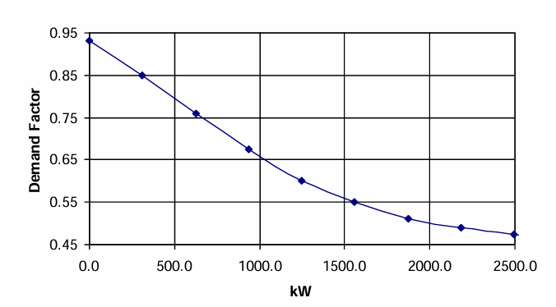
Demand factor analysis
Simple legacy method for determining
Current rating of cables feeding load centers and power panels
Current ratings of corresponding circuit breakers
Zonal load factor method and stochastic load analysis are preferred methods
Demand factor is obtained based on the sum of the connected loads expressed as current (for 450 V ac) or power for other voltages
DPC 310-1

Slide 10
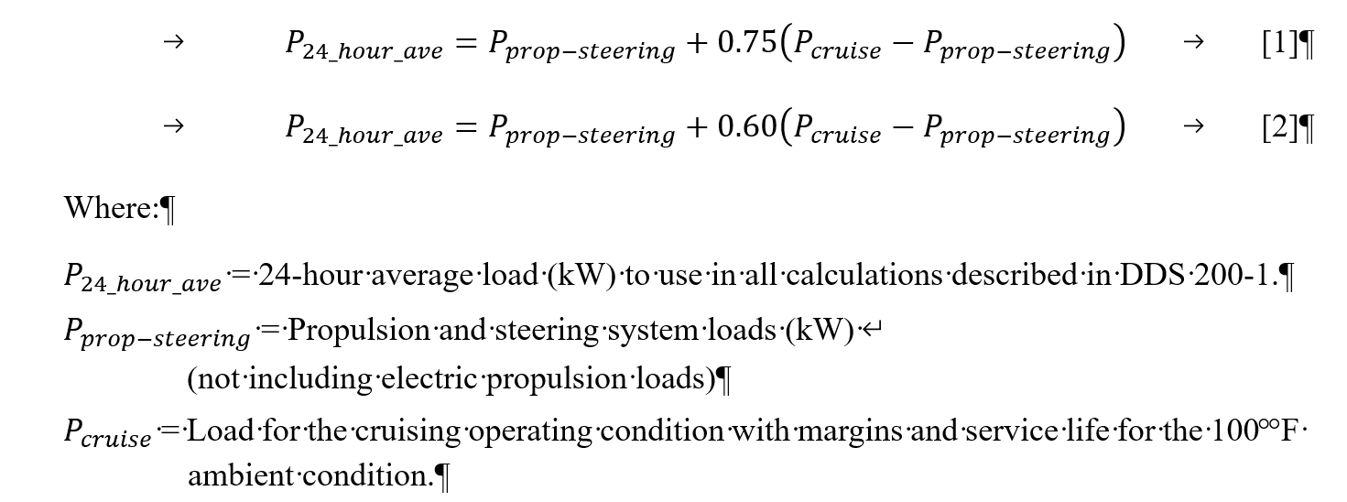
24-hour average load
Calculated at total ship level to support
Endurance fuel calculations
Annual fuel calculations
Load factor analysis
Load factor is kWh consumed in 24 hours divided by 24
Parametric equations may be used early when only have load factors for 100 °F ambient conditions for the purpose of determining generator set power ratings
Legacy method, other methods preferred
Should not be used in preliminary design or later
Equation [1] for all ships except aircraft carriers and large deck amphibious assault ships.
Equation [2] for aircraft carriers and large deck amphibious assault ships.
DPC 310-1

Slide 11
Load flow and limiting load flow
Load flow analysis
Determines voltages, power, and current at each node of a power system for a given operational condition and ambient condition.
Steady state analysis
Based on load properties from EPLA
Useful for determining
Bus-tie current rating
Power distribution equipment rating
Supports
Voltage drop calculations
Limiting load flow
Calculates an upper bound for power and currents without a detailed understanding of generator and load configurations
Levels
Simplest level: based only on generator set ratings
Less conservative level: refines simplest level by incorporating power system topology
Least conservative level: refines less conservative level by incorporating the impact of loads

Slide 12
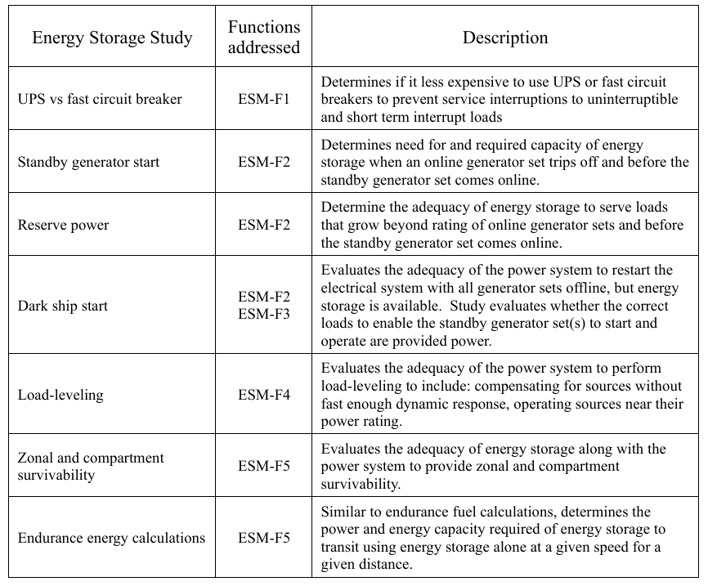
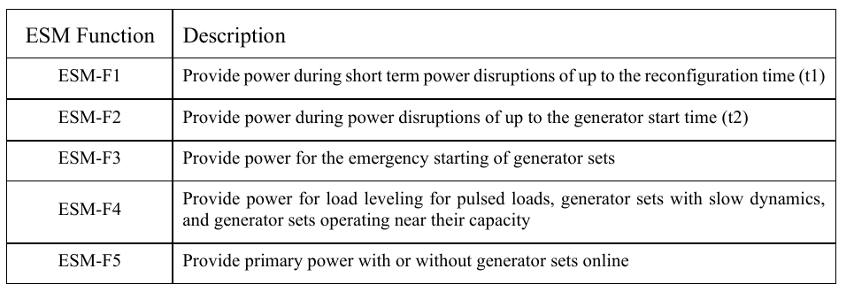
Energy storage capacity (power and energy) analysis
Five energy storage functions (ESM)
Multiple analyses to support the energy storage functions

Slide 13
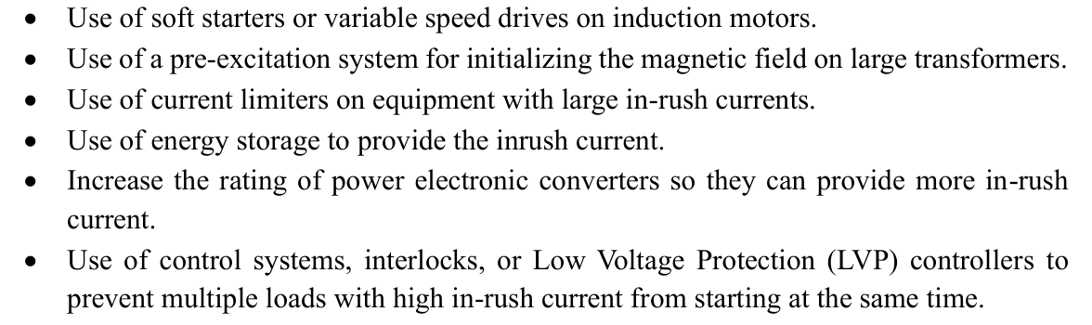
In-rush current analysis
In-rush current analysis compares the in-rush current requirements of loads with the capability of the generator sets or other sources to provide the in-rush current while maintaining interface standards
Equipment in-rush current requirements detailed in load list
Equipment with large in-rush current
Large transformers
Induction motors
Solenoid valves
Equipment with large input filter capacitors
Study cases
Many loads with large inrush come online at the same time
Dark ship recovery
Dead ship recovery
A load with large inrush current during shift in operating mode
In-rush current remediation technologies

Slide 14
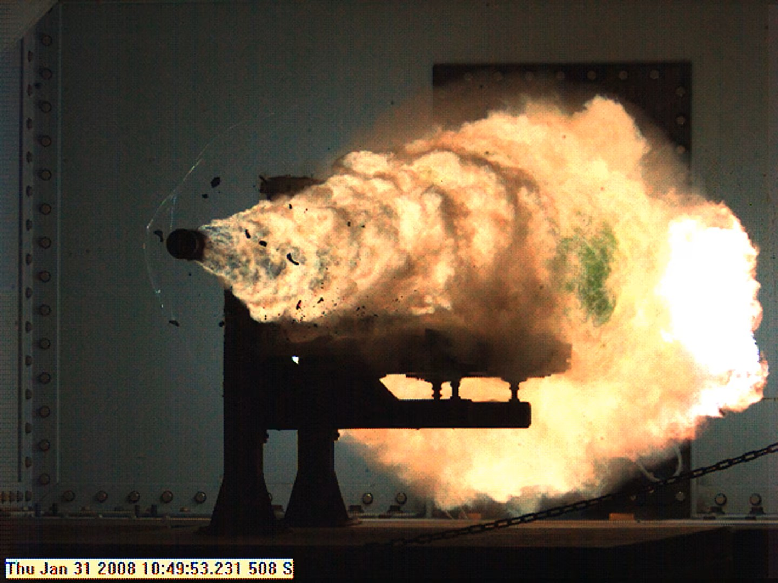
Pulsed load analysis
Examines ability of power system to support pulsed loads without impacting power quality to other loads
EPS CONOPS describes the intended ways for the power system to be operated to support pulsed loads
Subject pulse directly to the generator sets
Use energy storage to reduce impact on generator sets
Redirect power (when available) from other loads (such as propulsion)
EPLA provides an understanding of the other loads expected to be online and functional
Analysis should confirm
Power quality is maintained throughout the power system
Generator sets and other power system equipment are operated within their specification
The fault protection system has the capability of discriminating between the pulse and a fault
U.S. Navy Railgun Test
(US Navy Photo)

Slide 15
Quality of service analysis
Computes t1 and t2
Reconfiguration time (t1)
Generator start time (t2)
Assigns QOS category to all loads
Uninterruptible
Short term interrupt
Long term interrupt
Evaluates if Mean Time Between Service Interruption (MTBSI) requirements met
Requires estimating reliability properties of power system equipment
Redundancy (or lack thereof) can identify critical components to concentrate data collection efforts on

Slide 16

Endurance fuel calculations
Primary purpose is to determine the size of the fuel tanks
Endurance specified as one or more endurance set of metrics
Economical Transit
Economical transit distance and Endurance Speed
Surge to Theater
Surge to theater distance and Sustained Speed
Operational Presence
Operational mission
Speed – Time Profile
Operational Presence Time
Requires calculation of 24-hour average load for the applicable endurance set of metrics
Typically uses load factor analysis
May use parametric equation in early design stages
USS Donald Cook (DDG 75) USNS Laramie (T-AO 203)
(US Navy Photo)

Slide 17
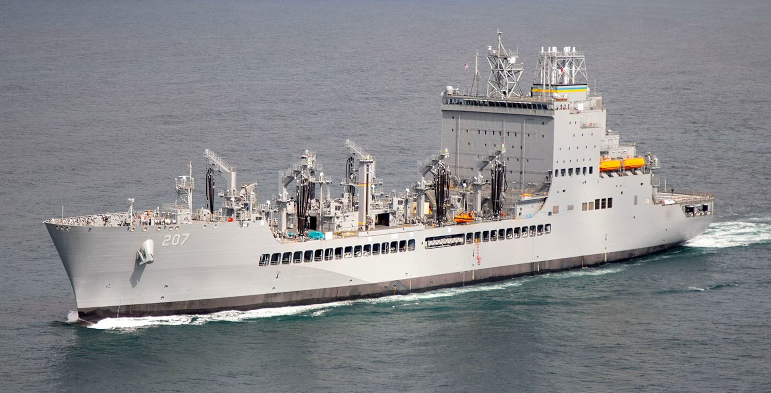
Annual energy usage and annual energy cost calculations
EPLA provides estimates for 24-hour averages for the different operational conditions.
When coupled with propulsion power requirements, used to estimate annual fuel consumption.
Annual fuel consumption used for
Determining whether ship meets energy efficiency requirements
Provide a basis for estimating the cost of fuel over the ship’s service life
Evaluate whether the shore-side and replenishment fleet refueling capacity is sufficient (naval ships)
USNS Earl Warren (T-AO 207)
(US Navy Photo)

Slide 18

Proxy Load
A proxy load is used to represent a load or group of loads
Uses of proxy load
Specific equipment may not be selected; proxy load provides an estimate of the load characteristics while not necessarily being derived from specific equipment.
Data is not available for selected equipment; the proxy load could have characteristics of similar, but not identical equipment for which the data is available.
Properties of loads or groups of load are parametrically estimated and assigned to the proxy load.
Lumping together multiple smaller loads that have the same connection to the power system. (electrical lighting and electrical heaters for example).
Combining loads that depend on each other, or are exclusive to each other; managing the interdependency with a proxy load may be convenient.
Combining many loads, whether defined or not, that have the same connection to the power system for the purpose of simplifying system models; this technique is useful for load flow analysis, endurance fuel calculations, and annual fuel calculations.
Proxy loads should clearly identify the equipment or types of equipment they contain.
If the proxy load includes a group of equipment, members of the group should be identified and the estimated characteristics for those members identified.
Electric Heater
USS Wisconsin (BB 64)
(Photo by Norbert Doerry)

Slide 19
EPLA Evolution
In earliest stages of design, virtually all the loads in the load list are likely to be proxy loads.
For each load, the load list may only estimate the connected
Load factors based on default values
As the design matures, update the load list
Add additional information to loads as needed by analysis
Concentrate on the largest 50 to 100 loads
Remove from proxy loads and model separately, loads that are defined
Adjust (or eliminate) the proxy loads to reflect the load removal
Model the loads using one or more of the modeling techniques
May employ proxy loads to group multiple loads from load list
During detail design and construction
Replace all proxy loads in the load list with actual loads
Improve the load models
During sea trials and ship operations
Instrument loads (preferably the 50 – 100 largest loads) to update load models

